Slide 1




Web Services Basic
Web Services Types, SoapUI
QA
Automation
SoftUni Team
Technical Trainers
Software University
http://softuni.bg

Slide 2

Table of Contents
Web Services
Terminologies
Data Formats
SOAP Services
RESTful Services
SoapUI
Basic SOAP Project
Basic REST Project

Slide 3
Have a Question?
sli.do #QA-Automation

Slide 4
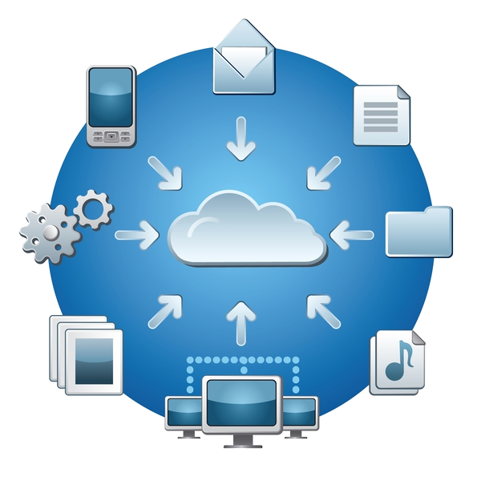
Web Services
Handle Pop-ups and Alerts

Slide 5
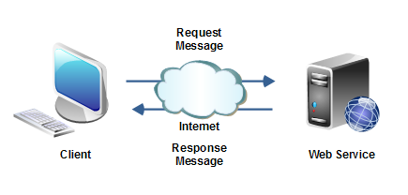
What is Web Service?
Services are available in the Web
Communication between the two system over network
Real Life Example:
Facebook, Google, Twitter, e-commerce sites, and irctc.

Slide 6
Web Service Definition
Software system designed to support interoperable machine-machine interaction over the network
(w3c definition)

Slide 7
Simple Use case
Interface
Application Server-1
Application Server-2
IRCTC- Ticket Service
BookTicket()
CancelTicket()
Dealer site1 (makemytrip.com)
Struts
Application Server-3
Dealer site2
(cleartrip.com)
.NET/RUBY
DB

Slide 8
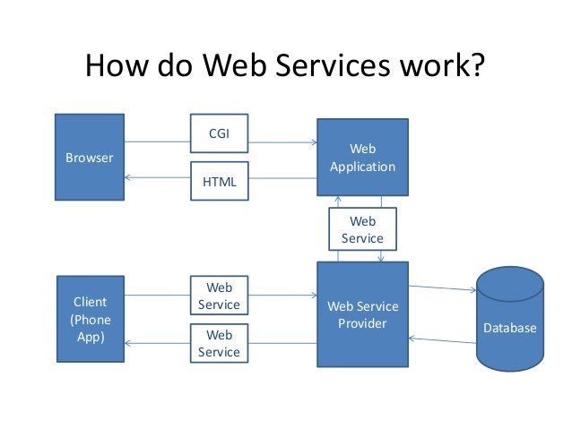
How do Web Services Work?

Slide 9
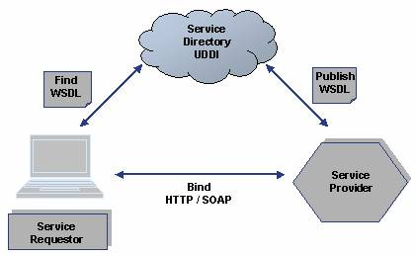
Criteria for interface and request/response
Interface should be platform independent
Request and response should be language natural

Slide 10
Web Service Terminologies
SOAP – Simple Object Access Protocol
Envelope for soap request/response
WSDL – Web Service Description Language
Interface for SOAP web service
UDDI – Universal Description, Discovery and Integration
Repository/yellow pages of web services
REST – Representational State Transfer
Architecture style of communication to the services
HTTP – Hypertext Transfer Protocol
Stateless protocol and used for transport

Slide 11
SOAP vs REST
SOAP
Client
Server
Data
+
SOAP
Standard
=
Huge Data
<=>
REST
Client
<=>
Sending data as its
Server
Data

Slide 12
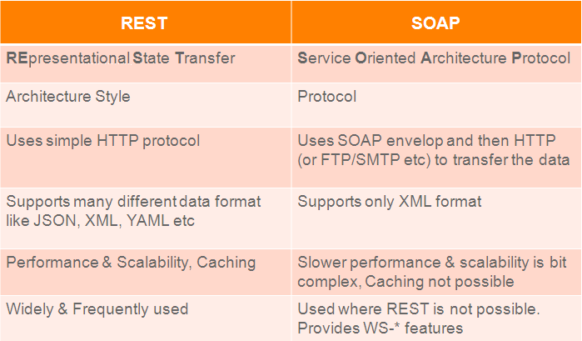
Different Types of Web Services

Slide 13
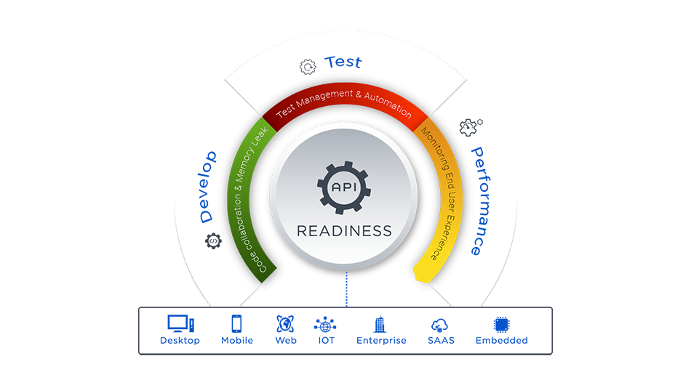
What to Test?
Response Correctness
Client part that uses this service
HTTP statuses
Authorization
Response timeout
Load testing
Security testing
Negative cases

Slide 14

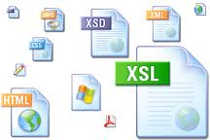

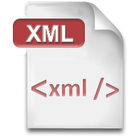


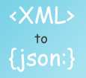

RESTful
Representational State Transfer

Slide 15

XML
XML is markup-language for encoding documents in machine-readable form
Text-based format
Consists of tags, attributes and content
Provide data and meta-data in the same time
<?xml version="1.0"?>
<library>
<book><title>HTML 5</title><author>Bay Ivan</author></book>
<book><title>WPF 4</title><author>Microsoft</author></book>
<book><title>WCF 4</title><author>Kaka Mara</author></book>
</library>

Slide 16
JSON (JavaScript Object Notation)
Standard for representing simple data structures and associative arrays
Lightweight text-based open standard
Derived from the JavaScript language
{
"firstName": "Bay",
"lastName": "Ivan",
"age": 79
}

Slide 17

RSS (Really Simple Syndication)
Family of Web feed formats for publishing frequently updated works
Based on XML, with standardized XSD schema
RSS documents (feeds) are list of items
Each containing title, author, publish date, summarized text, and metadata

Slide 18
RSS Example
<?xml version="1.0" encoding="utf-8" ?>
<rss version="2.0">
<channel>
<title>W3Schools Home Page</title>
<link>http://www.w3schools.com</link>
<description>Free web building tutorials</description>
<item>
<title>RSS Tutorial</title>
<link>http://www.w3schools.com/rss</link>
<description>New RSS tutorial on W3Schools</description>
</item>
</channel>
</rss>

Slide 19

SOAP
Simple Object Access Protocol

Slide 20

What is SOAP?
Communication protocol
Serves for communication between applications
Format for sending messages
Designed to communicate via Internet
Platform independent
Language independent
Based on XML
Simple and extensible
Allows you to get around firewalls

Slide 21
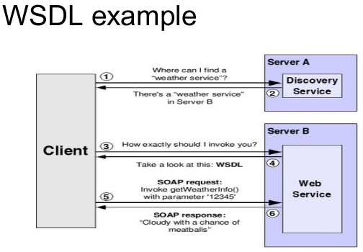
What is WSDL?
WSDL stands for Web Services Description Language
Serves for describing web services and how to access them
WSDL is written in XML
WSDL is an XML document
WSDL is used to describe and locate web services
WSDL is a W3C standard

Slide 22

Web Service Testing Challenges
Since web services are composed of loosely coupled distributed over networks, we must test the application:
End to end
Service to service
Interface by interface

Slide 23
How to Test a Web Service?
Web service has NO user interface
We can’t interact with it without a special tool
That tool should allow composing XML requests via its own user interface
Commonly such user interfaces are text editors
Used for writing your XML requests and controls for posting requests to the server

Slide 24
Web Service Test Automation
What if your web service contains too many methods?
With too many input and output parameters
Web Service testing can be automated
Automate validation of your web service’s response against input
Automate the output of validation results into a file
Could be just a text file of HTML depending on your choice

Slide 25

RESTful
Representational State Transfer

Slide 26
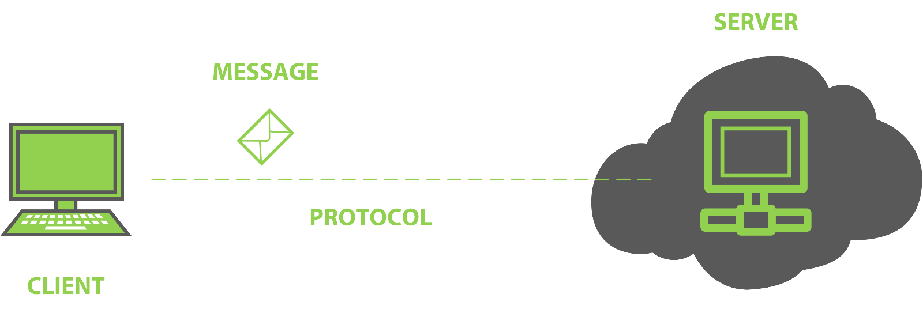
What is REST?
Application state and functionality are resources
Every resource has an URI
All resources share a uniform interface
This natively maps to the HTTP protocol

Slide 27
REST Definition
“Representational state transfer (REST) is a style of software architecture for distributed hypermedia systems such as the World Wide Web.”

Slide 28
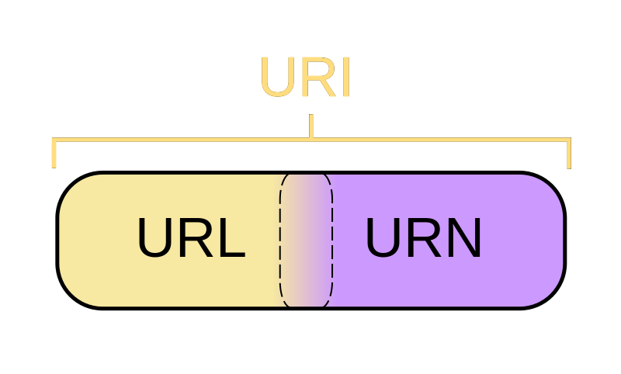
What is URI?
Uniform Resource Identifier in a RESTful web services is a hyperlink to a resource
It is only means for clients and servers to exchange representations of resources

Slide 29
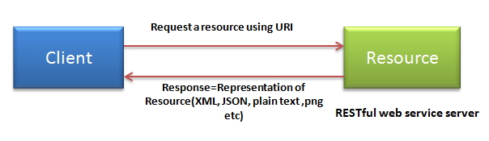
REST Concepts
The architecture consist:
Clients and servers
Requests and responses
Requests and responses are build around the transfer of representations of resources
Clients contain representations, servers the resources (concepts) themselves

Slide 30
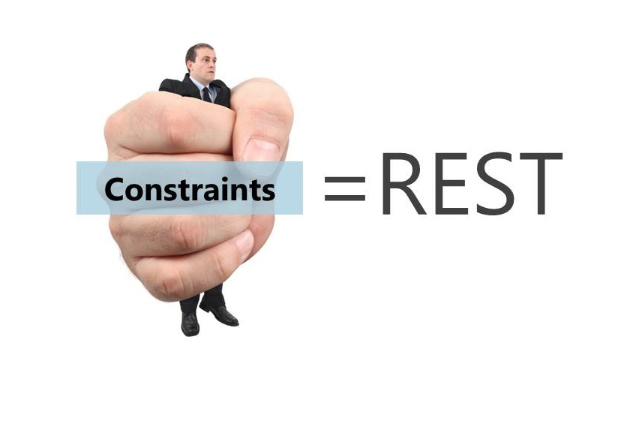
REST Constrains
RESTful system should be:
Client-server
Clients are separated from servers by a uniform interface
Stateless
There should be no need for the service to keep users' session
Each request should be independent of others

Slide 31
REST Constrains (2)
Cacheable
Clients are able to cache responses
Responses must, implicitly or explicitly, define themselves as cacheable or not
Uniformly accessible
Each resource must have a unique address and a valid point of access

Slide 32
REST Resources
Resource is "everything" the service can provide
State and functions of a remote application are also considered as resources
Anything that can be accessed and transferred between clients and servers
Resource must have a unique address over the Web
Under HTTP these are URIs

Slide 33

Representations
The representations of resources is what is sent back and forth clients and servers
We never send or receive resources, only their representations
The format of the representations is determined by the content-type

Slide 34

Hypertext Transfer Protocol (HTTP)
Actions are standard HTTP request
GET – retrieve a resource
POST – create a resource
PUT – update a resource
DELETE – delete a resource
They make up the uniform interface used for client/server data transfers

Slide 35


What is SoapUI?
Java-based cross-platform functional testing solution
Has two editions:
Free and open-source
Paid version – SoapUI Pro
Source: http://www.soapui.org

Slide 36

SoapUI Features
SoapUI provides various options for testing web services:
Functional testing
Load testing
Service Simulation (Mocking)
Security testing
REST testing

Slide 37
SoapUI Assertions
Schema Compliance
Simple Contains
Simple Not Contains
SOAP Fault
Not SOAP Fault
SOAP Response
Response SLA
XPath Match
XQuery Match
Script Assertion
WS-Security Status
WS-Addressing Response Assertion
WS-Addressing Request Assertion

Slide 38
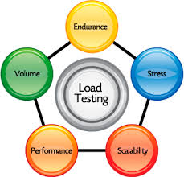
SoapUI Features
What SoapUI calls "Load Testing" is actually a "Performance Testing"
SoapUI offers an example of a Performance Testing categorization:
Baseline Testing
Load Testing
Stress Testing
Soak Testing
Scalability Testing

Slide 39

Summary
Web Services
Terminologies
Data Formats
SOAP Services
RESTful Services
SoapUI
Basic SOAP Project
Basic REST Project

Slide 40







Service Testing Basic
https://softuni.bg/courses/

Slide 41
License
This course (slides, examples, demos, videos, homework, etc.) is licensed under the "Creative Commons Attribution-NonCommercial-ShareAlike 4.0 International" license

Slide 42





Free Trainings @ Software University
Software University Foundation – softuni.org
Software University – High-Quality Education, Profession and Job for Software Developers
softuni.bg
Software University @ Facebook
facebook.com/SoftwareUniversity
Software University @ YouTube
youtube.com/SoftwareUniversity
Software University Forums – forum.softuni.bg

